Slide 1

Approximate Q Learning VS Deep Q Learning
Team: Elvis Fernandez

Slide 2
Problem Statement
To better investigate the difference between the two I had to switch to a much simpler problem than the Bipedal Walker initially selected. In retrospect, to better highlight the differences I recommend an even smaller problem than the one selected for this project.
Deep Q learning uses a lot of resources and google collab quickly runs out of resources.

Slide 3
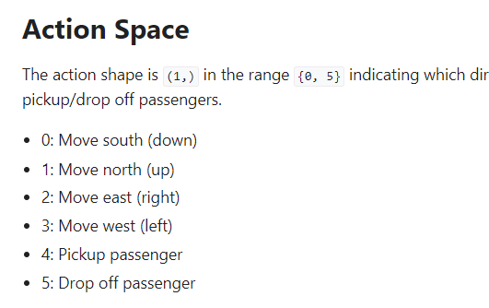
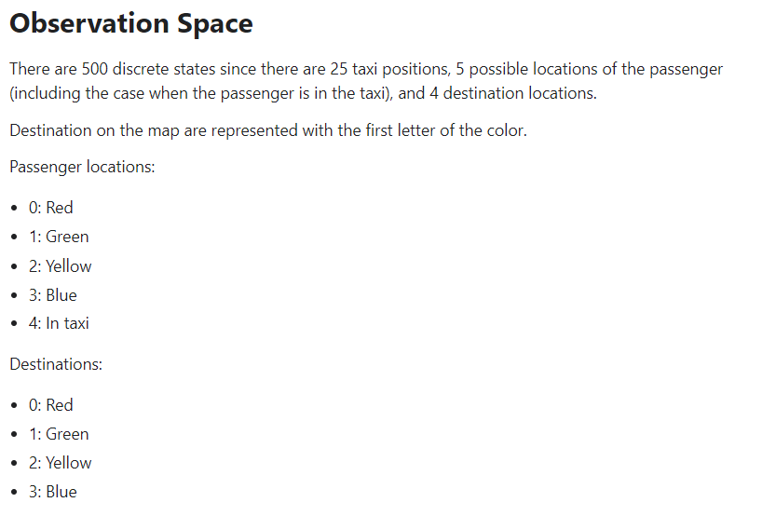
Taxi-v3
Discrete action and observation spaces.
Action space represented in 6 states
Observation space in 500

Slide 4
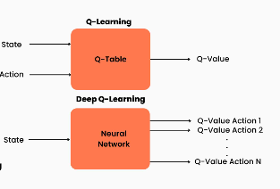
Differences
The biggest difference which becomes quite obvious as soon as you execute the training code is Deep Q Learning stores a lot more information than Approximate Q Learning.
Another difference is DQL should be able to converge given just the state. In comparison to AQL which requires the state as well as action space.

Slide 5
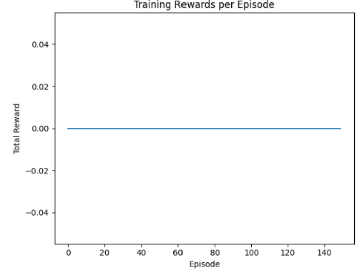
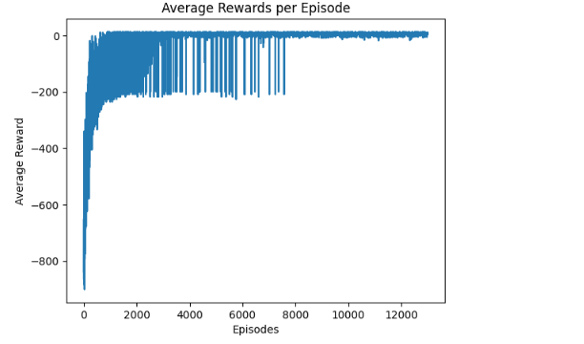
Differences Contd.
I was able to get Approximate Q Learning to converge at 9000 episodes. (8600 if aiming for non-negative rewards)
However, I could not get DQL to get past 300 episodes without crashing my collab environment. Below are average reward metrics for both :

Slide 6

Conclusion
In conclusion, the amount of time and resources needed to run DQL is too high to use in light exploration/experimentation. Whereas AQL is light robust and yields very nice results, especially when int exploration/experimentation stages of a given problem.

